Slide 1
Digit Classification With MLP

Slide 2
Digit Classification With MLP
Topics:
Representations for Images in computer memory
Classifying images with a MLP
Improving classification accuracy

Slide 3
Representing images in computer memory

Slide 4
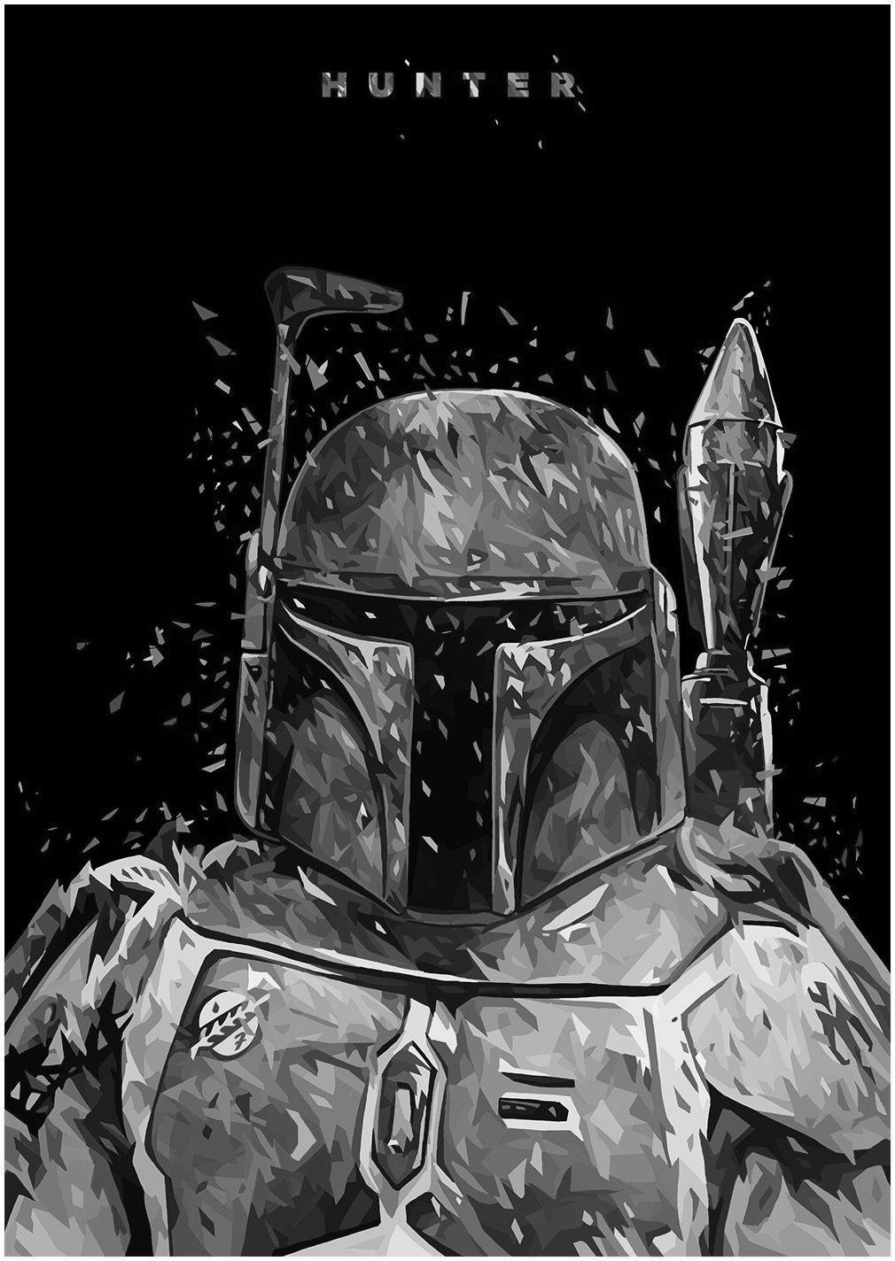
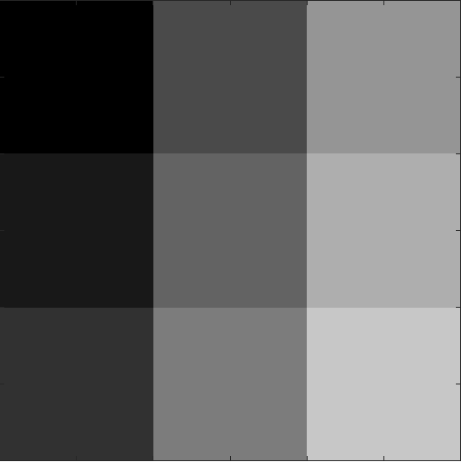
Images in memory
Image: A collection of pixels usually arranged in a rectangular grid
Pixel: The smallest component of an image. A pixel can be represented by either one number (grayscale images) or three numbers (color images)
Grayscale Pixels are represented by any real value in the range [0-255], with 0 as black and 255 as white
In computers, images are represented by matrices, with each entry representing one pixel
Grayscale Images: A grayscale image can be represented by a single matrix in computer memory
Photo by: Alessandro Pautasso
0
75
150
25
100
175
50
125
200

Slide 5

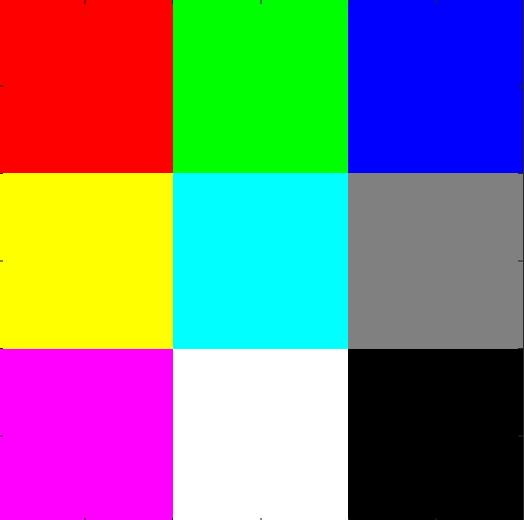
Images in memory
Color Pixels are represented by three color channels (matrices), red, blue, and green (RGB). Each channel is represented by a real value in the range [0-255], with 0 representing black and 255 representing the color
Color Channels are additive such that the final pixel color is a combination of red, blue, and green
Grayscale Images require fewer computations to process than Color Images due to grayscale requiring one matrix instead of three
Photo by: Alessandro Pautasso
255
0
0
0
255
0
0
0
255
255
0
128
255
255
128
0
255
128
255
255
0
0
255
0
255
255
0

Slide 6

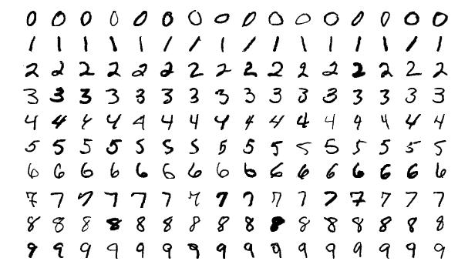
WHAT IS MNIST?
The dataset we will be using for the coding example
MNIST (Modified National Institute of Standards and Technology) is the “Hello World” of ML image processing
MNIST is a collection of handwritten digit images (0 – 9) contained in images that are 28 pixels wide by 28 pixels high
The training dataset contains 60,000 images, and the testing dataset contains 10,000 images
This dataset acts as a standard “benchmark” for evaluating the performance of image classification algorithms

Slide 7
Classifying images with mlp

Slide 8
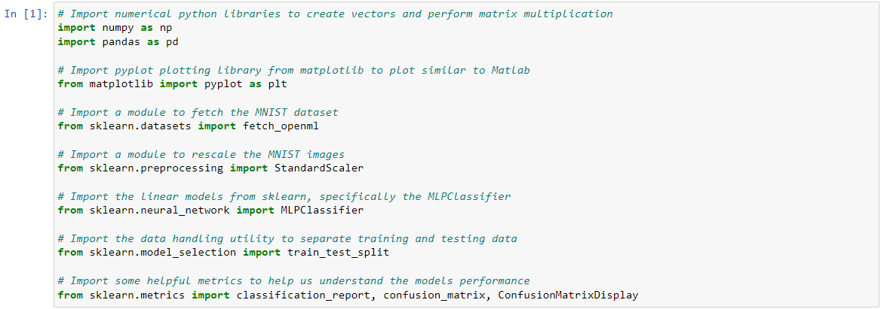
Classifying images with mlp

Slide 9
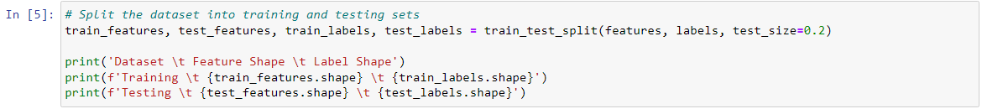
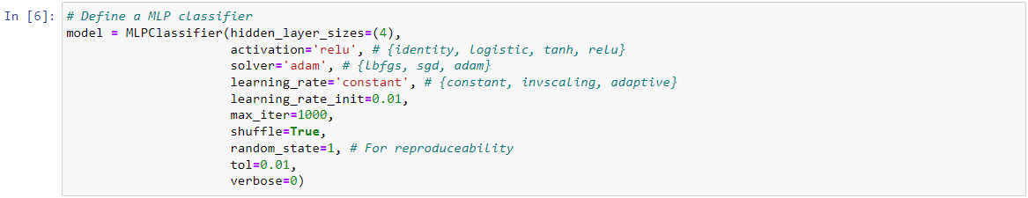
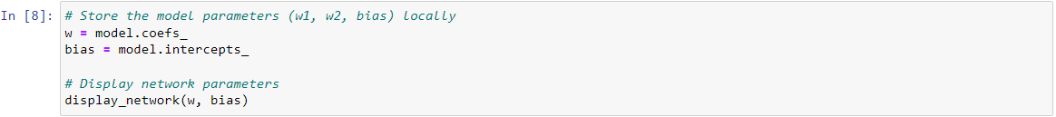
Classifying images with mlp

Slide 10
Classifying images with mlp

Slide 11
Improving classification accuracy

Slide 12
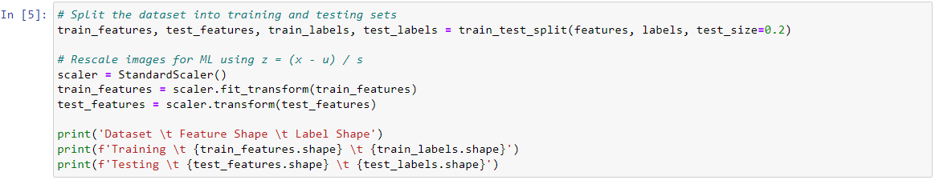
Improving classification accuracy
Image Normalization
Neural networks typically assume the input features are similar in magnitude
Neural networks work best on properly scaled input data
min-max scaling: rescale to the range [0,1]
Z-Score Normalization: standardize the data such that \mu = 0 and std = 1
Raw pixel values can be any real number in the range [0,255], and we did not rescale the data earlier

Slide 13
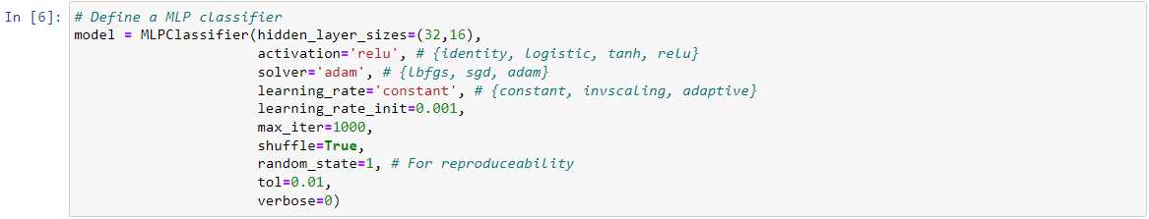
Improving classification accuracy
Tuning Network Architecture
The network can be too complex or not complex enough to solve the problem
If the network is too:
Big/Complex - It will Overfit (memorize) the training dataset and perform poorly on the validation and tests datasets
Small/Simple – It will Underfit (not learn) the training dataset and will be unusable
A properly sized network can achieve over 95% accuracy on the MNIST testing set
Try different architectures such as a triangle (2, 4, 8) or diamond (2, 4, 2) shape

